Slide 1
School of Engineering and Technology
Course: Fundamentals of Data Science
MODULE 1
INTRODUCTION TO DATASCIENCE

Slide 2
CONTENTS
1.1 INTRODUCTION
DEFINITION
NEED FOR DATA SCIENCE
1.2 BIGDATA
DATA COLLECTIONS
DATA WAREHOUSE
1.3 DATA SCIENCE HYPE
1.4 DATAFICATION
1.5 DATA SCIENCE PROFILES
1.6 DEFINITIONS
METADATA
STATISTICAL INFERENCE
POPULATION AND SAMPLES
DATA MODELLING
1.7 PHYLOSOPHY OF EXPLORATORY DATA ANALYSIS
1.8 DATASCIENCE PROCESS
1.9 DATASCIENCETIST’S ROLE
1.10 CASE STUDIES

Slide 3
1.1 INTRODUCTION
Over the past few years, there’s been a lot of hype in the media about “data science” and “Big Data.” Today, Data rules the world. This has resulted in a huge demand for Data Scientists.
A Data Scientist helps companies with data-driven decisions, to make their business better. Data science is a field that deals with unstructured, structured data, and semi-structured data. It involves practices like data cleansing, data preparation, data analysis, and much more.
Data science is the combination of: statistics, mathematics, programming, and problem-solving; capturing data in ingenious ways; the ability to look at things differently; and the activity of cleansing, preparing, and aligning data. This umbrella term includes various techniques that are used when extracting insights and information from data.

Slide 4
What is Data Science?
Data science is a deep study of the large amount of data, which involves extracting meaningful insights from raw, structured, and unstructured data that is processed using the scientific method, different technologies, and algorithms.
Data science uses the most powerful hardware, programming systems, and most efficient algorithms to solve the data related problems. It is the future of artificial intelligence.
Data Science is about data gathering, analysis and decision-making.
Data Science is about finding patterns in data, through analysis, and make future predictions.

Slide 5
Need for Data Science
Data Science is used in many industries in the world today, e.g. banking, consultancy, healthcare, and manufacturing.
For route planning: To discover the best routes to ship
To foresee delays for flight/ship/train etc. (through predictive analysis)
To create promotional offers
To find the best suited time to deliver goods
To forecast the next years revenue for a company
To analyze health benefit of training
To predict who will win elections

Slide 6
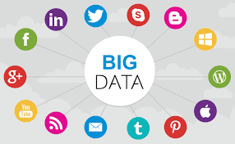
1.2 BIG DATA
Big data refers to significant volumes of data that cannot be processed effectively with the traditional applications that are currently used. The processing of big data begins with raw data that isn’t aggregated and is most often impossible to store in the memory of a single computer.

Slide 7
Big data is used to analyze insights, which can lead to better decisions and strategic business moves.
Big data is high-volume, and high-velocity or high-variety information assets that demand cost-effective, innovative forms of information processing that enable enhanced insight, decision making, and process automation.
Types of Big data,
1.Structured
2.Unstructured
3.Semi-Structured
Businesses that use big data effectively hold a potential competitive advantage over those that don't because they're able to make faster and more informed business decisions.

Slide 8
Applications of Big Data
Big Data for Financial Services
Credit card companies, retail banks, private wealth management advisories, insurance firms, venture funds, and institutional investment banks all use big data for their financial services.
The common problem among them all is the massive amounts of multi-structured data living in multiple disparate systems, which big data can solve.
Big data is used in several ways, including:
Customer analytics
Compliance analytics
Fraud analytics
Operational analytics

Slide 9
DATA COLLECTION
Data collection is the process of acquiring, collecting, extracting, and storing the voluminous amount of data which may be in the structured or unstructured form like text, video, audio, XML files, records, or other image files used in later stages of data analysis.
In the process of big data analysis, “Data collection” is the initial step before starting to analyze the patterns or useful information in data. The data which is to be analyzed must be collected from different valid sources.
The actual data is then further divided mainly into two types known as:
1. Primary data
2. Secondary data

Slide 10
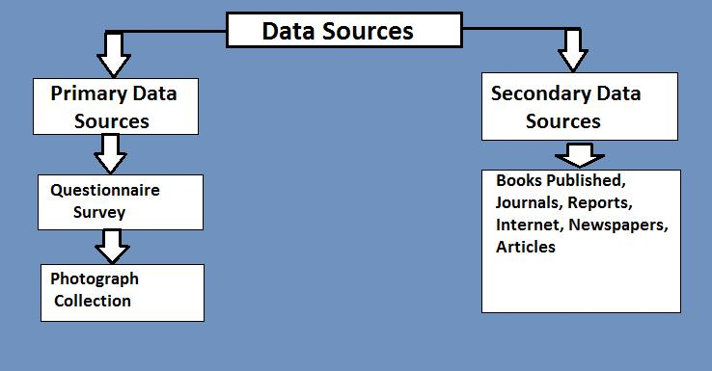

Slide 11
DATA WAREHOUSE
A data warehouse is an enterprise system used for the analysis and reporting of structured and semi-structured data from multiple sources, such as point-of-sale transactions, marketing automation, customer relationship management, and more. A data warehouse is suited for ad hoc analysis as well custom reporting.
Goals of Data Warehousing
1. To help reporting as well as analysis
2. Maintain the organization's historical information
3. Be the foundation for decision making

Slide 12
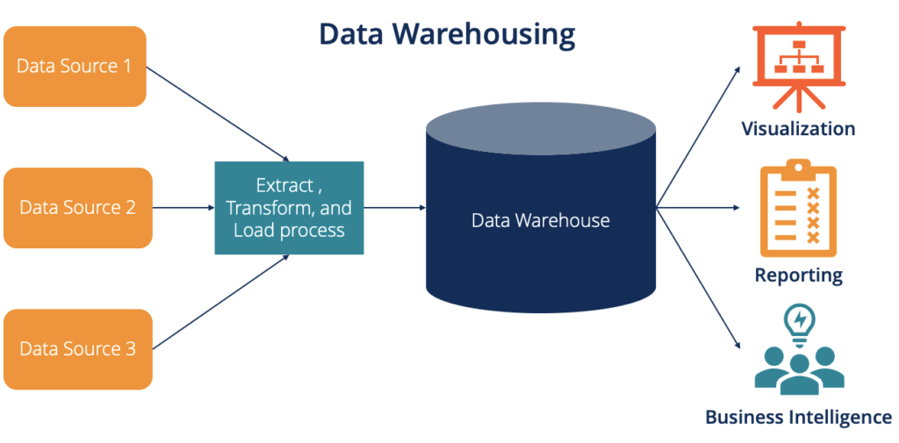

Slide 13
1.3 DATA SCIENCE HYPE
The hype is crazy—people throw around tired phrases straight out of the height of the pre-financial crisis era like “Masters of the Universe” to describe data scientists.
Statisticians already feel that they are studying and working on the “Science of Data.”
The media often describes data science in a way that makes it sound like as if it’s simply statistics or machine learning in the context of the tech industry.
Data science enables companies not only to understand data from multiple sources but also to enhance decision making.
Data Science has been recognized as one of the most exciting IT domains in the world. Recent reports suggest that leading countries like USA and China are investing billions of dollars to integrate their industries with Artificial Intelligence (AI).

Slide 14
There’s a lack of definitions around the most basic terminology. What is “Big Data” anyway? What does “data science” mean? What is the relationship between Big Data and data science? Is data science the science of Big Data? Is data science only the stuff going on in companies like Google and Facebook and tech companies? Why do many people refer to Big Data as crossing disciplines (astronomy, finance, tech, etc.) and to data science as only taking place in tech?
There’s a distinct lack of respect for the researchers in academia and industry labs who have been working on this kind of stuff for years, and whose work is based on decades (in some cases, centuries) of work by statisticians, computer scientists, mathematicians, engineers, and scientists of all types.
From the way the media describes it, machine learning algorithms were just invented last week and data was never “big” until Google came along. Many of the methods and techniques we’re using—and the challenges we’re facing now.

Slide 15
1.4 DATAFICATION
Datafication as a process of “taking all aspects of life and turning them into data.” As examples, they mention that “Google’s augmented-reality glasses datafy the gaze. Twitter datafies stray thoughts. LinkedIn datafies professional networks.”
Datafication is an interesting concept and led us to consider its importance with respect to people’s intentions about sharing their own data.
We are being datafied, or rather our actions are, and when we “like” someone or something online, we are intending to be datafied, or at least we should expect to be. But when we merely browse the Web, we are unintentionally, or at least passively, being datafied through cookies that we might or might not be aware of. And when we walk around in a store, or even on the street, we are being datafied in a completely unintentional way, via sensors, cameras, or Google glasses.

Slide 16
Datafication refers to the collective tools, technologies, and processes used to transform an organization into a data-driven enterprise.
An organizational trend of defining the key to core business operations through a global reliance on data and its related infrastructure.
Datafication refers to the fact that daily interactions of living things can be rendered into a data format and put to social use.
Benefits of Datafication
1. Datafication is a technique that is financially advantageous to pursue since it provides great opportunity for streamlining corporate procedures.
2. Datafication is a cutting-edge process for creating a futuristic framework that is both secure and inventive.

Slide 17
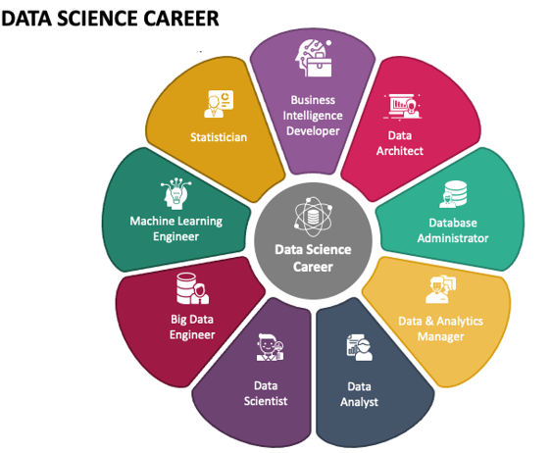
1.5 Data Science Profiles

Slide 18
Data Analyst
Data Analysts are the individuals who are responsible for reviewing the data so that they can identify the key information in the businesses of customers. Therefore, it is the process of collecting, processing, and analyzing the data to extract meaningful insights and also data analyst support in decision- making processes.
Data Scientist
Data Scientist are the individual who uses the data to understand it. Therefore these data scientist are responsible to collect, analyze and interpret the data to help to drive the decision making.
Data Engineer
Data Engineer refers to experts who are responsible for maintaining, designing and optimizing the data infrastructure for the data management and transform them.

Slide 19
1.6 DEFINITIONS - METADATA
Metadata means "data about data". Metadata is defined as the data providing information about one or more aspects of the data; it is used to summarize basic information about data that can make tracking and working with specific data easier.
There are three main types of metadata: Descriptive, Administrative, and Structural.
Descriptive metadata enables discovery, identification, and selection of resources. It can include elements such as title, author, and subjects.
Examples:
Library Catalogs: Metadata about books, including title, author, publication date, subject headings, and ISBN.
Digital Repositories: Descriptive information about digital objects, such as datasets, images, and documents, including titles, creators, descriptions, and formats.

Slide 20
Administrative metadata facilities the management of resources.
Administrative metadata is a type of metadata that helps manage and support the use of a resource, typically digital objects, throughout its lifecycle. It encompasses information needed for managing, preserving, and providing access to the resource.
Components of Administrative metadata,
Technical Metadata.
Preservation Metadata
Rights Management Metadata
Examples :
Digital Libraries: Metadata about digitized books, manuscripts, and other resources, including technical details, preservation actions, and rights information.
Archives: Metadata for archival collections, detailing provenance, custodial history, and access permissions.

Slide 21
Structural Metadata is metadata that describes the structure, type, and relationships of data. For example, in a SQL database, the data is described by metadata stored in the Information Schema and the Definition Schema.
Examples
Books and Documents: Information about chapters, sections, and sub-sections, as well as pagination and links between different parts of the document.
Multimedia Objects: Metadata describing scenes, segments, tracks, or frames in videos and audio files.
Websites: The organization of web pages, including navigation structures, links, and the relationship between different sections of the site.
Digital Collections: How items in a collection are grouped, ordered, and related to each other, such as collections of photographs, datasets, or archival materials.

Slide 22
Statistical Inference: Statistical inference is a method of making decisions about the parameters of a population, based on random sampling. It helps to assess the relationship between the dependent and independent variables. The purpose of statistical inference to estimate the uncertainty or sample to sample variation.
Population and Sample in big data:
Data: Both population and sample involve data. Population refers to the entire group or set of individuals, objects, or events being studied, while a sample is a subset of the population that is used for analysis. Descriptive Statistics: Descriptive statistics can be used to analyse both populations and samples.
Example: All the students in the class are population whereas the top 10 students in the class are the sample. All the members of the parliament is population and the female candidates present there is the sample.

Slide 23
DATA MODELLING
Data modeling is the process of creating a visual representation of either a whole information system or parts of it to communicate connections between data points and structures.
Data modeling is a process of creating a conceptual representation of data objects and their relationships to one another. The process of data modeling typically involves several steps, including requirements gathering, conceptual design, logical design, physical design, and implementation.
Data Modeling in software engineering is the process of simplifying the diagram or data model of a software system by applying certain formal techniques. It involves expressing data and information through text and symbols. The data model provides the blueprint for building a new database or reengineering legacy applications.
Data Modeling thus helps to increase consistency in naming, rules, semantics, and security. This, in turn, improves data analytics. The emphasis is on the need for availability and organization of data, independent of the manner of its application.

Slide 24
1.7 Philosophy of Exploratory Data Analysis
Exploratory Data Analysis (EDA) is an analysis approach that identifies general patterns in the data. These patterns include outliers and features of the data that might be unexpected. EDA is an important first step in any data analysis.
Important steps:
Import Libraries
Configure Settings
Prepare Data
Import Data set files
Null Value Check

Slide 25
Exploratory data analysis (EDA) is used by data scientists to analyze and investigate data sets and summarize their main characteristics, often employing data visualization methods.
EDA helps determine how best to manipulate data sources to get the answers you need, making it easier for data scientists to discover patterns, spot anomalies, test a hypothesis, or check assumptions.
EDA is primarily used to see what data can reveal beyond the formal modelling or hypothesis testing task. It provides a better understanding of data set variables and the relationships between them.
It can also help determine if the statistical techniques you are considering for data analysis are appropriate. Originally developed by American mathematician John Tukey in the 1970s, EDA techniques continue to be a widely used method in the data discovery process today.

Slide 26
The main purpose of EDA is to help look at data before making any assumptions. It can help identify obvious errors, as well as better understand patterns within the data, detect outliers or anomalous events, find interesting relations among the variables.
Data scientists can use exploratory analysis to ensure the results they produce are valid and applicable to any desired business outcomes and goals.
EDA can help answer questions about standard deviations, categorical variables, and confidence intervals. Once EDA is complete and insights are drawn, its features can then be used for more sophisticated data analysis or modelling, including machine learning.

Slide 27
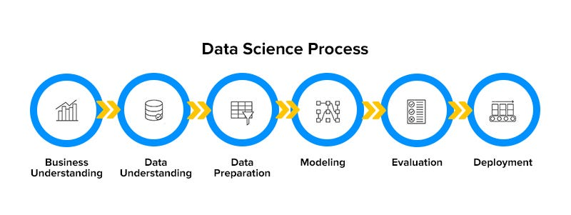
1.8 DATA SCIENCE PROCESS
Step 1: Defining the problem. The first step in the data science lifecycle is to define the problem that needs to be solved. ...
Step 2: Data collection and preparation
Step 3: Data exploration and analysis
Step 4: Model building and evaluation
Step 5: Deployment and maintenance.

Slide 28
Defining the problem: The first step in the data science lifecycle is to define the problem that needs to be solved.
Data collection: After formulating any problem statement the main task is to calculate data that can help us in our analysis and manipulation. Sometimes data is collected by performing some kind of survey and there are times when it is done by performing scrapping.
Data cleaning: Most of the real-world data is not structured and requires cleaning and conversion into structured data before it can be used for any analysis or modeling.
Exploratory data analysis: This is the step in which we try to find the hidden patterns in the data at hand. Also, we try to analyze different factors which affect the target variable and the extent to which it does so. How the independent features are related to each other and what can be done to achieve the desired results all these answers can be extracted from this process as well. This also gives us a direction in which we should work to get started with the modeling process.

Slide 29
4. Model building: Different types of machine learning algorithms as well as techniques have been developed which can easily identify complex patterns in the data which will be a very tedious task to be done by a human.
5. Model deployment: After a model is developed and gives better results on the holdout or the real-world dataset then we deploy it and monitor its performance. This is the main part where we use our learning from the data to be applied in real-world applications and use cases.

Slide 30
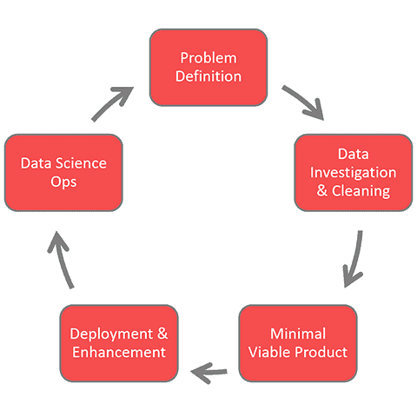
DATA SCIENCE PROCESS LIFECYCLE

Slide 31
DATA SCIENCE PROCESS LIFECYCLE
Problem definition: Generally, the project lead or product manager manages this phase. Regardless, this initial phase should:
State clearly the problem to be solved and why
Motivate everyone involved to push toward this why
Define the potential value of the forthcoming project
Identify the project risks including ethical considerations.
Data Investigation and Cleaning: Without data, you’ve got nothing. Therefore, the team needs to identify what data is needed to solve the underlying problem. Then determine how to get the data:
Is the data internally available? -> Get access to it
Is the data readily collectable? -> Start capturing it
Is the data available for purchase? -> Buy it
Once you have the data, start exploring it. Your data scientists or business/data analysts will lead several activities such as:
Document the data quality.
Clean and visualize the data.
Combine various data sets to create new views.

Slide 32
DATA CLEANING & PREPARATION: Before making analyzing the data, it is important to clean and prepare data. The methods used to clean and prepare the data are as listed below:
Changing Data Types of Columns from object to Floats
Filling in Missing Information
Checking For Duplicate Rows
Splitting Long Strings
Creating Various New Columns
Minimal Viable Model/Product
All data science life cycle frameworks have some sort of modelling phase. However, I want to emphasize the importance of getting something useful out as quickly. This concept borrows from the idea of a Minimal Viable Product.
“The minimum viable product is that version of a new product which allows a team to collect the maximum amount of validated learning about customers with the least effort.”
Or more simply — don’t start out building a full-fledged product and then launch. Rather, get out something of value and receive feedback about whether it is on the right track. And if not, shift directions.

Slide 33
Deployment and Enhancements: Deployment: Typically the more “engineering-focused” team members such as data engineers, cloud engineers, machine learning engineers, application developers, and quality assurance engineers execute this phase.
“No machine learning model is valuable, unless it’s deployed to production.”
Enhancements:
Extend the model to similar use cases (i.e. a new “Problem Definition” phase)
Add and clean data sets (i.e. a new “Data Investigation and Cleaning” phase)
Try new modelling techniques (i.e. developing the next “Viable Model”)
Data Science Ops:
As data science matures into mainstream operations, companies need to take a stronger product focus that includes plans to maintain the deployed systems long-term. There are three major overlapping facets of management to this.

Slide 34
1.9 A DATA SCIENTIST’S ROLE
Involves leveraging data to derive actionable insights and support data-driven decision-making. Their responsibilities can be summarized into several key areas:
Problem Definition
Collaborate with stakeholders to understand business objectives and translate them into data science problems.
Data Collection
Identify and gather relevant data from various sources using techniques like web scraping, APIs, and database querying.
Data Cleaning and Preprocessing
Clean and preprocess data by handling missing values, removing duplicates, and transforming data into a suitable format for analysis.
Exploratory Data Analysis (EDA)
Perform descriptive statistics and create visualizations to uncover patterns and insights within the data.

Slide 35
Feature Engineering
Create and select important features to enhance model performance and reduce dimensionality.
Model Building
Choose appropriate algorithms, train models, and fine-tune parameters to optimize performance.
Model Evaluation
Evaluate models using relevant metrics and validate them to ensure they generalize well to new data.
Model Deployment
Develop and implement a strategy for deploying models into production environments, ensuring seamless integration with existing systems.
Monitoring and Maintenance
Continuously monitor model performance, update and retrain models as necessary, and perform error analysis to refine models.

Slide 36
Communication and Reporting
Present findings and insights through clear and compelling storytelling, creating reports and dashboards for stakeholders.
Ethical Considerations
Ensure data privacy, compliance with regulations, and mitigate biases to promote fairness and ethical use of data.
Continuous Learning
Stay updated with the latest advancements in data science and continuously experiment with new techniques and tools.
In essence, a Data Scientist combines technical skills with business acumen to transform data into valuable insights that drive strategic decisions and operational improvements.

Slide 37
1.10 CASE STUDIES
Case Study in Data Science - Urban Planning and Smart Cities.
Case Study in Data Science - Housing Market Analysis

